Slide 1
Labmate
A smart lab companion for graduate students
Yonwoo choi
Emma pruvost
Hyoyoung lho
Nishadi prasangini

Slide 2
Target Users & Problem
Life of a graduate student is tough…

Slide 3

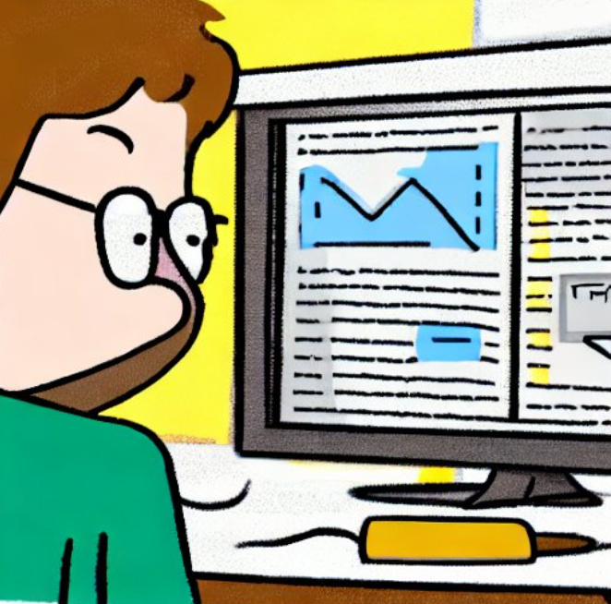
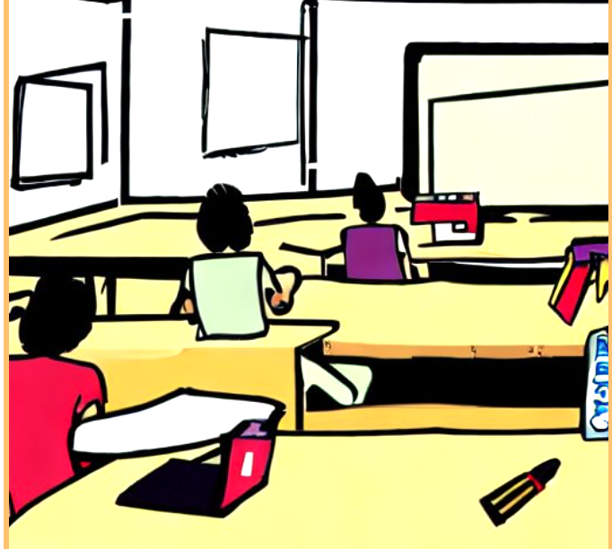

Target Users & Problem
Life of a graduate student is tough…
Meeting with Professor
Writing Papers
Doing Research
Coursework

Slide 4
Target Users & Problem
“Too much work to do”
“Wish I could focus solely on my research”

Slide 5
Target Users & Problem
Stress
The stress rate increases exponentially as time goes on
Time

Slide 6
Target Users & Problem
Users start using our application
Stress
By using our application, the stress levels will decrease naturally

Slide 7
Key Solution
Functions of our application
1. Monitoring GPU usage on lab server
2. Meal queue, seating availability checker
3. Meal recommendation

Slide 8
Function 1: GPU server usage monitor

Slide 9
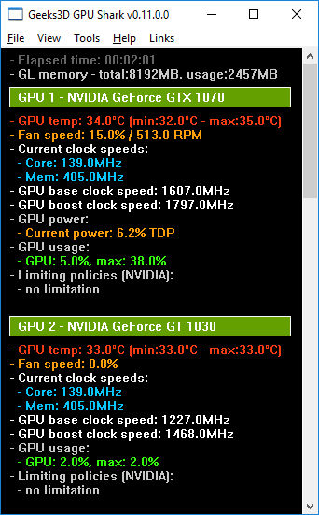
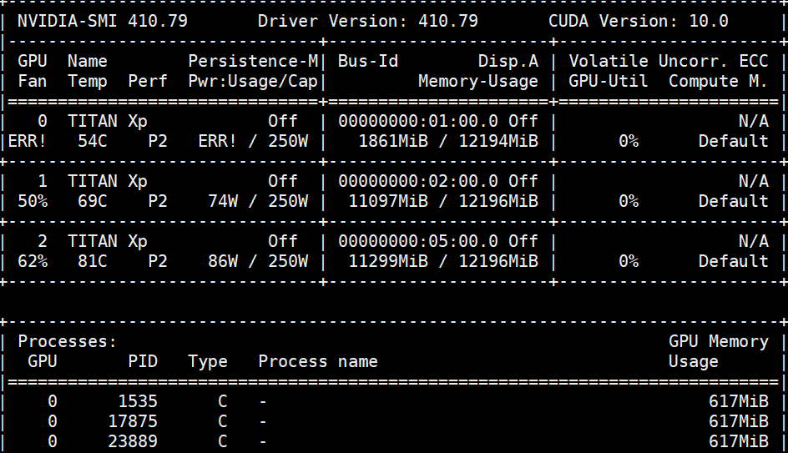
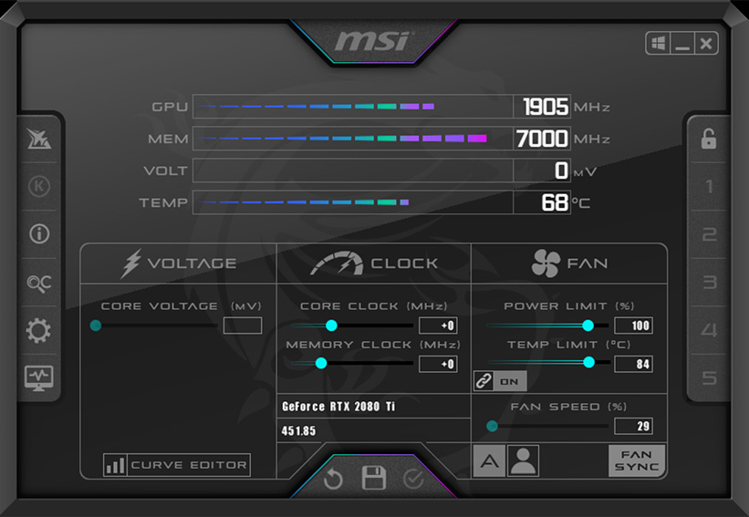
Existing Solutions & Limitations
Monitoring GPU usage on lab server – existing solutions
Nvidia-smi
GPU Shark
MSI Afterburner

Slide 10

Existing Solutions & Limitations
Monitoring GPU usage on lab server – limitations

Slide 11


Existing Solutions & Limitations
Monitoring GPU usage on lab server – limitations

Slide 12


Key Solution
Monitoring GPU usage on lab server – our solution
Server 1
Server 2
Server 3

Slide 13

Expected Challenges & Solutions
Monitoring GPU usage on lab server – expected challenges & solutions
Difficulty 1: Collecting data from multiple servers
Solution:
Use Ray’s built-in support for distributed systems to gather GPU information from each server.
An opensource, distributing library for building flexible parallel, and distrubuted applications.

Slide 14
Expected Challenges & Solutions
Monitoring GPU usage on lab server – expected challenges & solutions
Difficulty 2: Real-time data updates and synchronization
Solution:
Implement a mechanism to periodically fetch the latest GPU
data from the servers
2. Use a suitable polling interval to balance performance and responsiveness.

Slide 15
Expected Challenges & Solutions
Monitoring GPU usage on lab server – expected challenges & solutions
Difficulty 3: Security and access control
Solution:
Implement appropriate security measures to protect sensitive GPU data and control access to the monitoring system
Configure comminication channels, implement authentication and authorization.
Implment monitoring for potential security threats

Slide 16
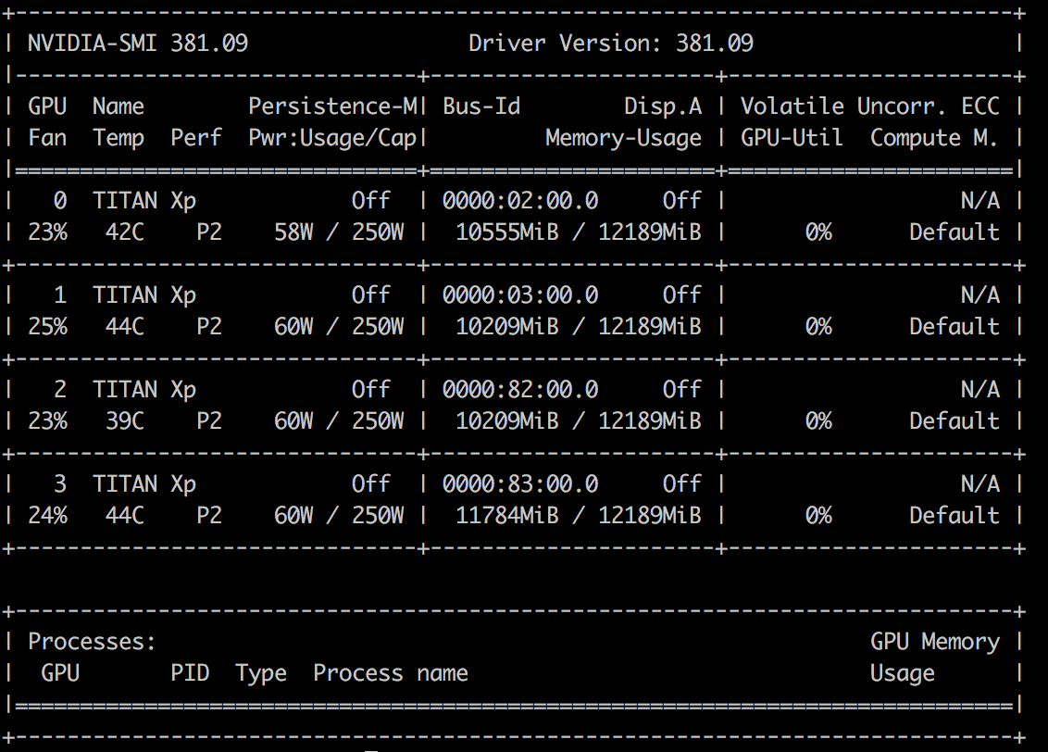
Evaluation Strategy
Monitoring GPU usage on lab server – evaluation strategy
Sync between actual usage value (result of nvidia-smi) and value on app
User experience (easy UX)

Slide 17
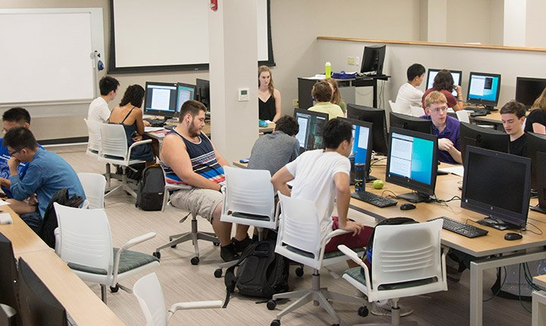
Usage Scenario
Monitoring GPU usage on lab server – usage scenario
Yonwoo needed to use more GPUs to obtain faster results for his paper deadline next week
He was assigned only 2 GPUs for himself and was afraid to ask other students if they were using their assigned GPUs
He used Labmate’s GPU activity monitor and verified that some GPUs were not in use
There was an agreement with the lab members that anyone with need could use idle GPUs
Yonwoo was able to train his model faster and submitted his paper on time

Slide 18
Function 2: Meal queue, seating availability checker

Slide 19
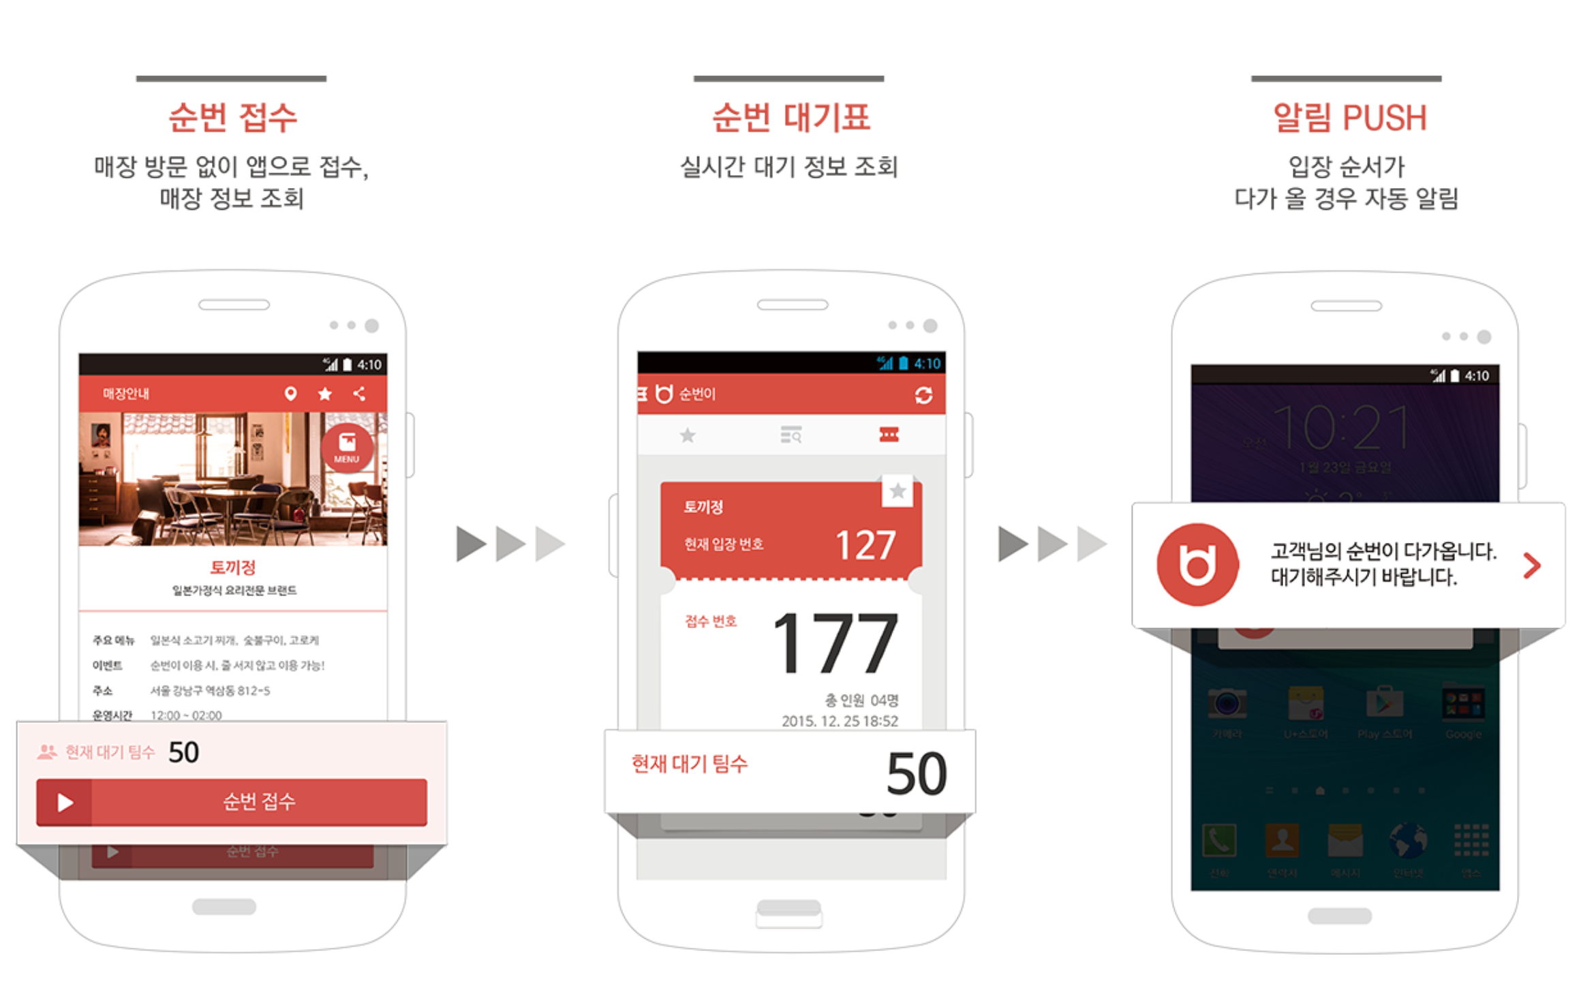

Existing Solutions & Limitations
Meal queue, seating availability checker – existing solutions

Slide 20
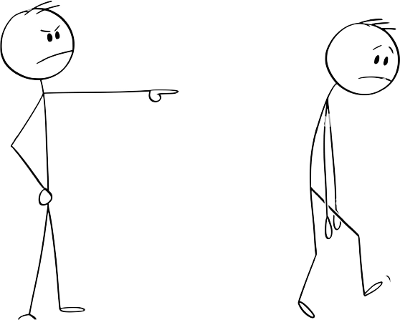
Existing Solutions & Limitations
Meal queue, seat availablity checker – limitations
Forcing every user to use the app

Slide 21


Existing Solutions & Limitations
Meal queue, seat availablity checker – limitations
Doesn’t take account of people picking up food

Slide 22
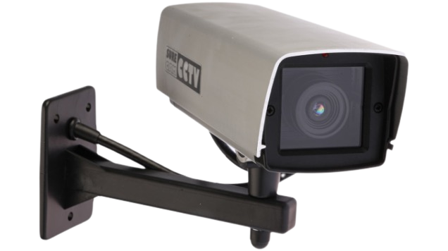
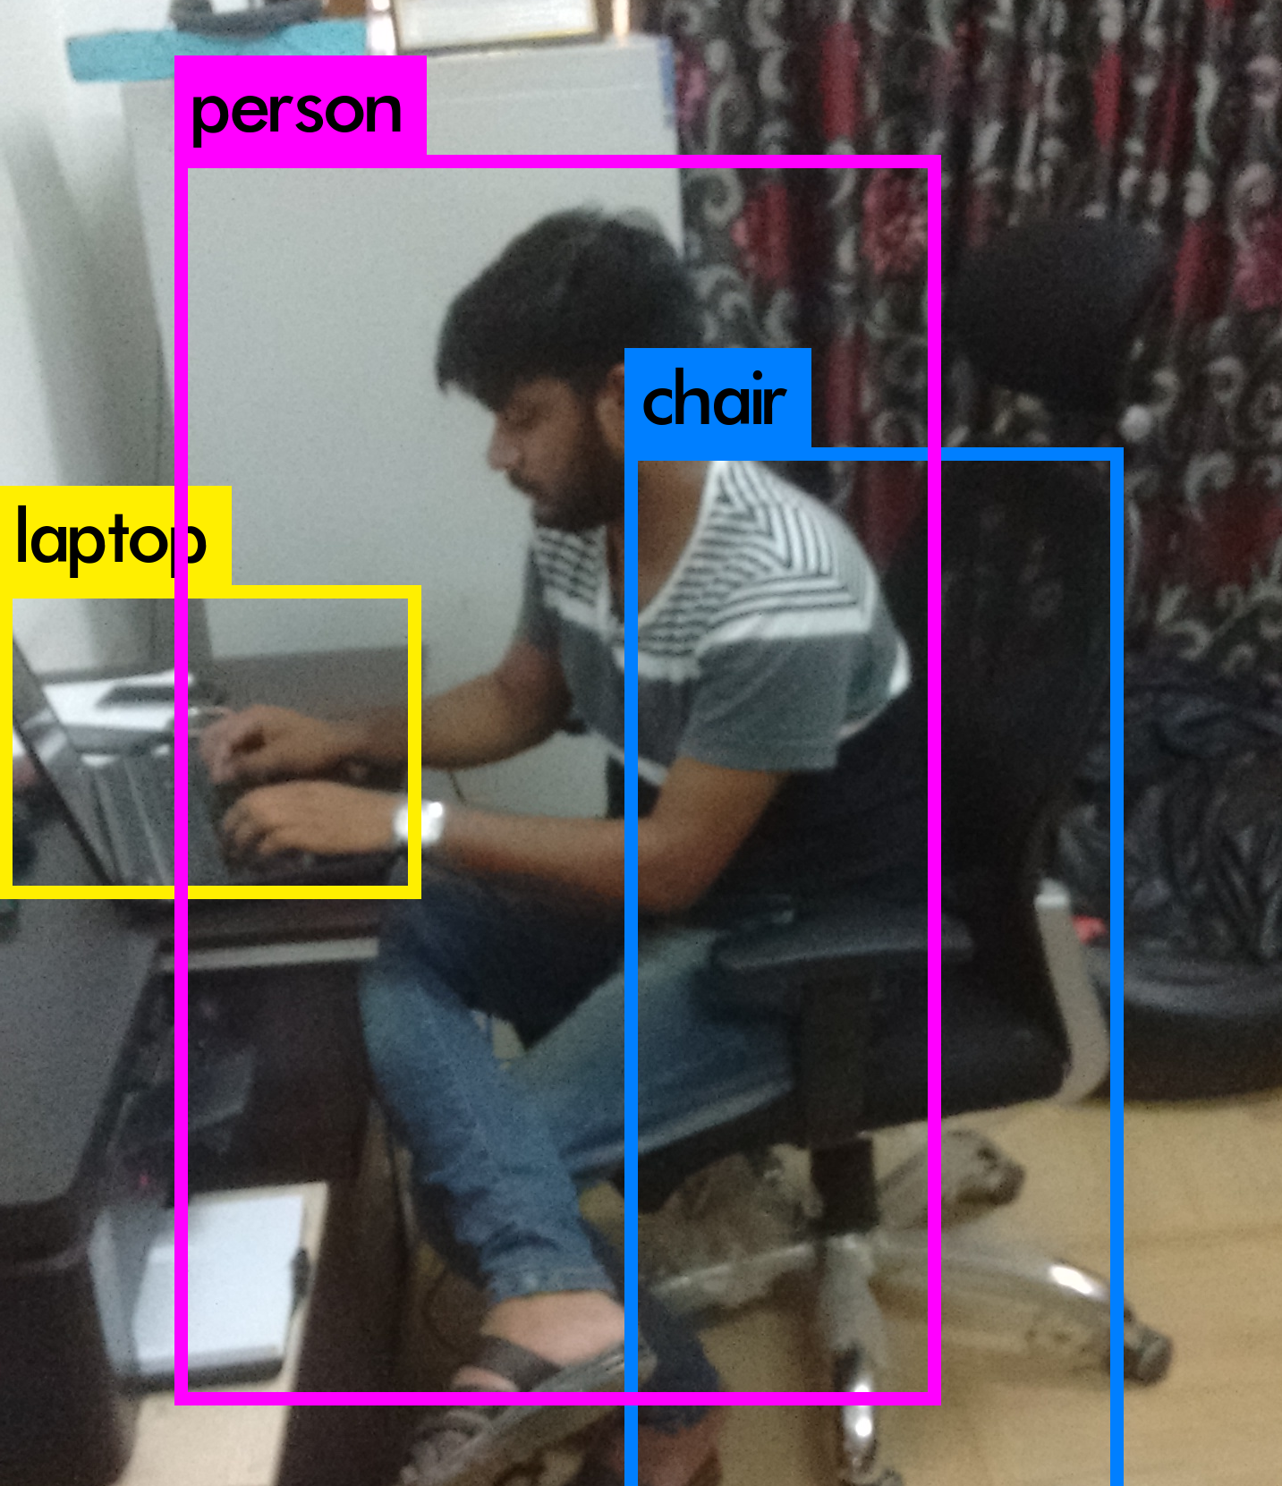
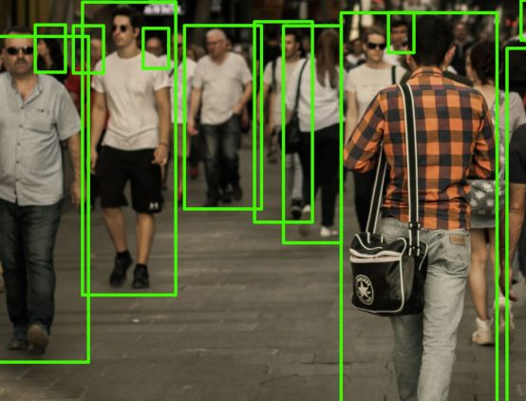
Key Solution
Meal queue, seat availablity checker – our solution
Sensors (cameras)
Vision - Human Object Detection

Slide 23
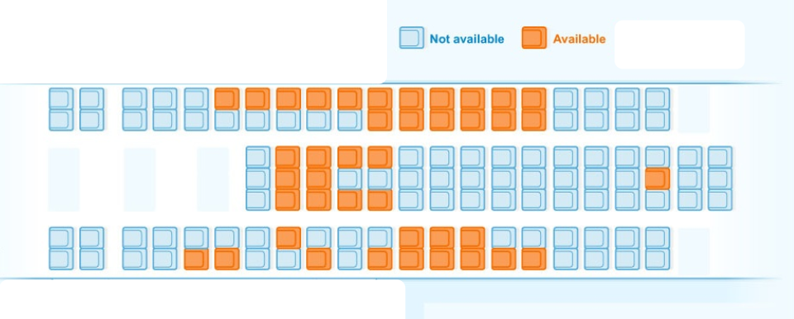
Key Solution
Meal queue, seat availablity checker – our solution
48 seats available
7 people in line
Estimated wait time is 3 minutes
Highly recommended heading to line!
Output – Seatplan
Output – Alert

Slide 24
Expected Challenges & Solutions
Meal queue, seat availablity– expected challenges & solutions
Difficulty 1: Accurate Human Detection
Solution:
1. Test various deep learning models such as YOLO, Faster R-CNN which are pretrained on large datasets and achieve high accuracy in detecting humans.

Slide 25
Expected Challenges & Solutions
Meal queue, seat availablity– expected challenges & solutions
Difficulty 2: Reliable empty seat detection
Solution:
Use template matching, feature matching or deep learning-based object detection.
Access to large chair dataset with various seating types, arrangements, and lighting conditions.

Slide 26
Expected Challenges & Solutions
Meal queue, seat availablity– expected challenges & solutions
Difficulty 3: Privacy Issues
Solution:
Anonymizing or blurring faces when storing captured data

Slide 27
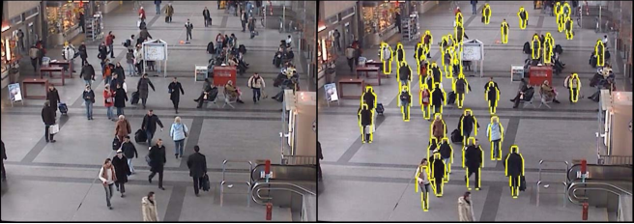
Evaluation Strategy
Meal queue, seat availablity– evaluation strategies
1. Number of human, chair detection accuracy
2. Detection, classification speed
3. User experience (easy UX)

Slide 28
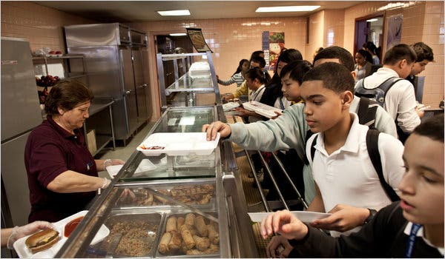
Usage Scenario
Meal queue, seat availablity – usage scenario
Yonwoo and 4 other friends was hungry so he decided to turn on Labmate’s Meal queue function.
Unfortunately, there were not any seats that 5 people could sit next to each other.
After a couple of more minutes, Yonwoo turned the app again and verified that the waitime was reasonable, and there were multiple spaces for 5 students.
Yonwoo and his friends headed off to the cafeteria and had lunch in a breeze.

Slide 29
Function 3: Meal Recommender System

Slide 30
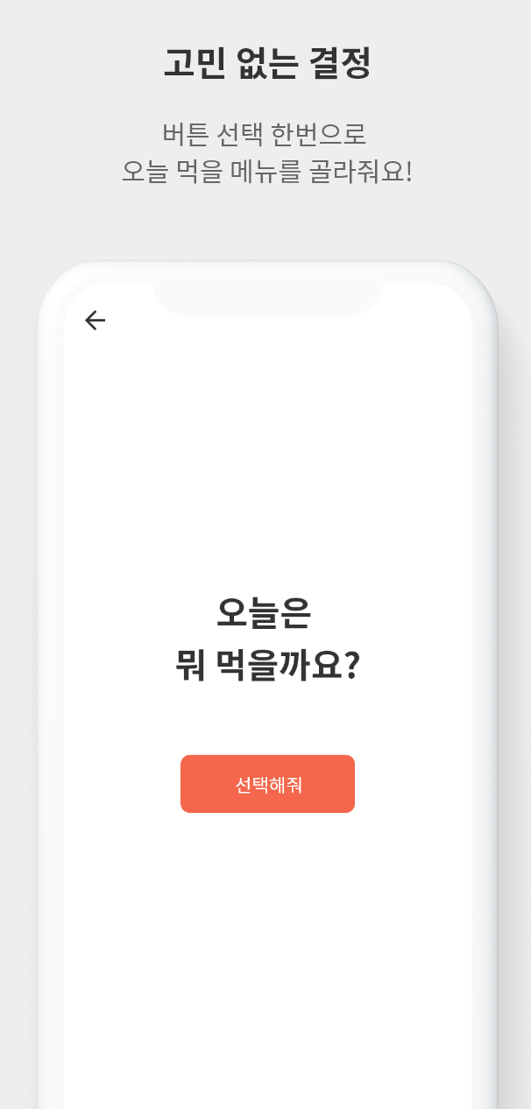
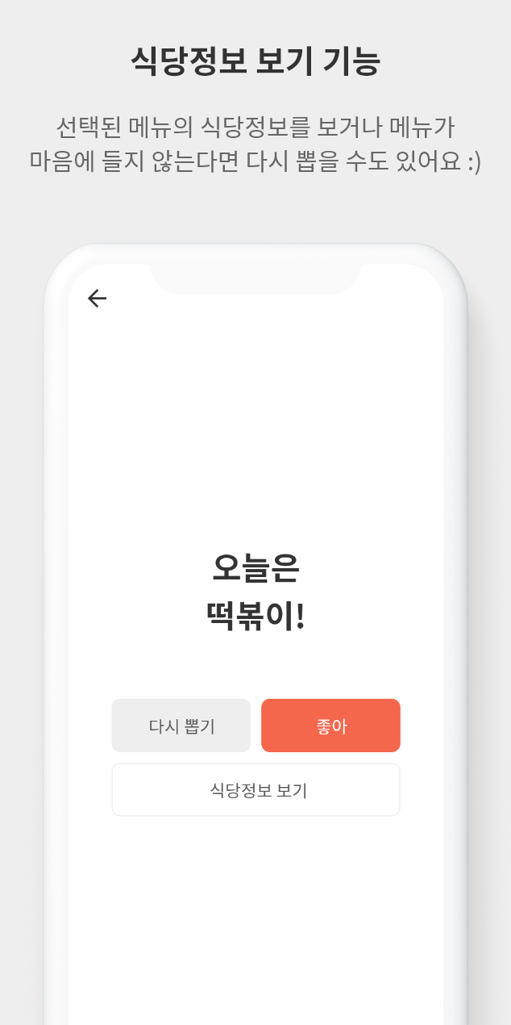
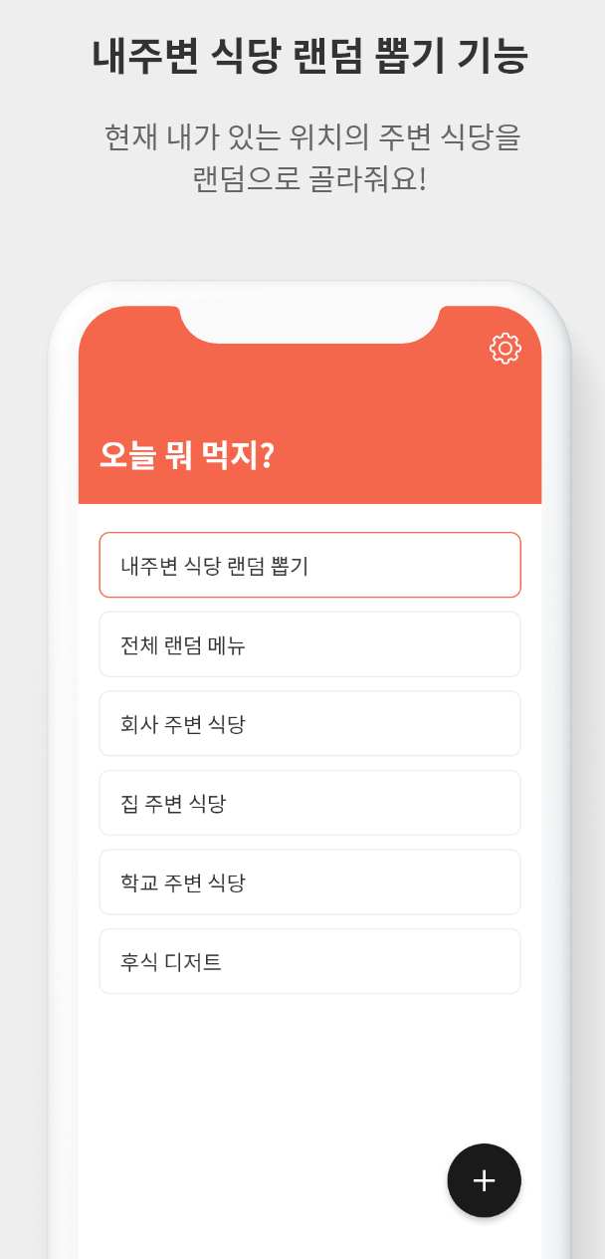

Existing Solutions & Limitations
Meal recommendation– exisiting solutions

Slide 31

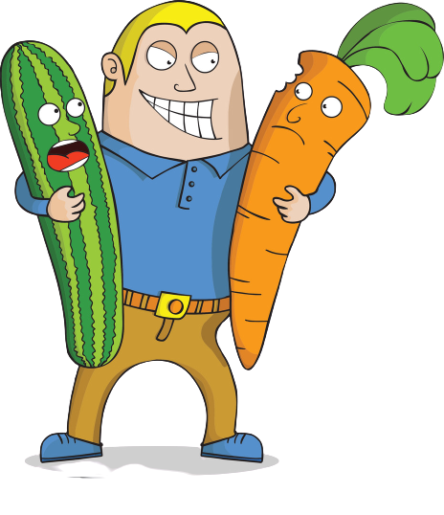
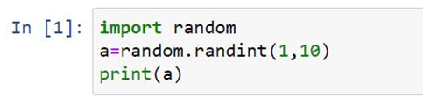
Existing Solutions & Limitations
Meal recommendation– limitations
Do not take into account user diet and many other factors

Slide 32

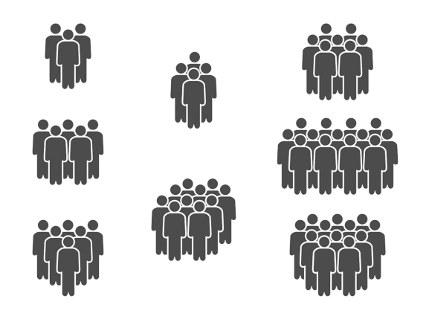
Existing Solutions & Limitations
Meal recommendation– limitations
No grouping

Slide 33
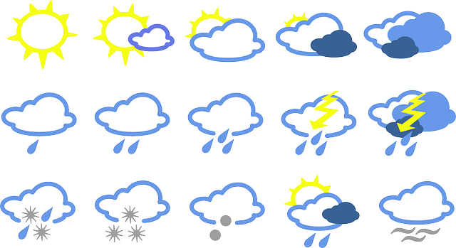
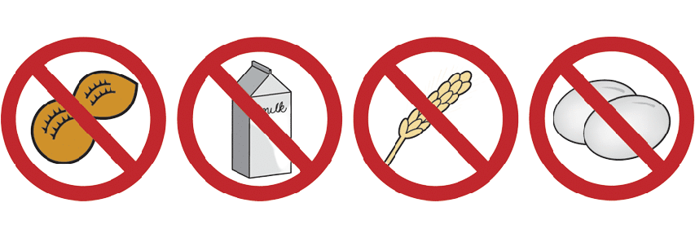
Key Solution
Meal recommendation– our solution
Recommendation based on weather, diet, allergies

Slide 34
Key Solution
Meal recommendation– our solution
Grouping

Slide 35

Key Solution
Meal recommendation– our solution
Cycle check

Slide 36
Expected Challenges & Solutions
Meal Recommendation – expected challenges & solutions
Difficulty 1: Handling complex dietary restrictions and allergies
Solution:
Creating a comprehensive databaes of ingredients, dishes, and their potential allergens to ensure meal recommendations are safe and suitable for all users.
Implementing a system to cross-reference users’ allergies and dietary preferences with ingredients in recommended dishes.

Slide 37
Expected Challenges & Solutions
Meal Recommendation – expected challenges & solutions
Difficulty 2: Adapting to changes in weather, diets, and allergies
Solution:
Involve periodic data updates and an adaptive recommendation algorithm
Create a feedback mechanism that allows users to rate and provide feedback on the recommended meals.

Slide 38
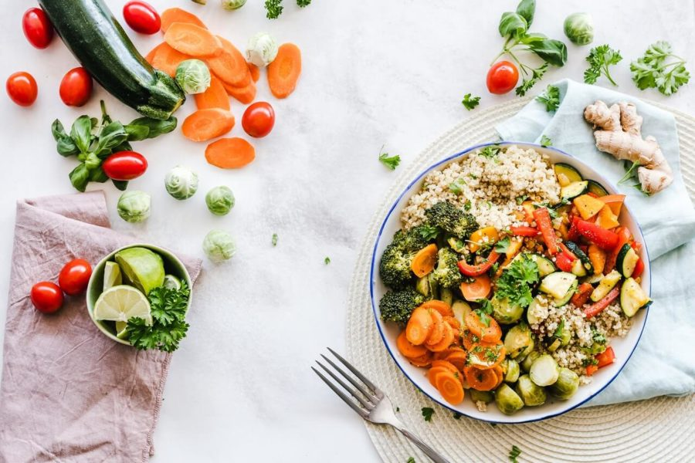
Evaluation Strategy
Meal Recommendation – evaluation strategies
Checking if recommended meal does not relate to group member’s allergies
Checking if same types of recommendations are not given in a certain time period
Checking if the meal is in compliance with the weather
Measuring the speed of recommendation
User experience (easy UX)

Slide 39

Usage Scenario
Meal recommendation– usage scenario
Yonwoo and his colleagues had a difficult time deciding what menu to order for dinner.
They agreed to use the meal recommendation function in Labmate.
Taking into consideration the rainy weather, the allergies of group members, and diet, the app recommended 부대찌개 (Korean soup) as it met everyone’s requirements without triggering any allergies.
Thanks to the application taking weather as a consideration to meal recommendation, Yonwoo and his colleagues had a warm, comforting meal suitable for a rainy weather.

Slide 40
Execution Plan
Overall project plan
Tasks | Week | 4 | 5 | 6 | 7 | 8 | 9 | 10 | 11 | 12 | 13 | 14 | 15
Presentation | Present | YW |  |  |  |  |  | HY + EM |  |  |  |  | HY or EM + NI
 | PPT | YW |  |  |  |  |  | HY + EM |  |  |  |  | HY or EM + NI
GPU usage monitor | Get familiar with Ray |  | YW | YW
 | Create development environment |  |  |  | YW | YW | YW
 | Develop distributed application |  |  |  |  |  |  |  | YW | YW | YW | YW
Meal queue | Prepare Equipment | HY | HY
 | Test different models |  |  | HY | HY
 | Develop detection pipeline |  |  |  |  | HY | HY |  | HY | HY | HY | HY
Meal Recommendor | Gather Data | EM | NI
 | Build/train recommendor system |  |  | EM+NI | EM+NI | EM+NI | EM+NI
 | Develop system pipeline |  |  |  |  |  |  |  | EM+NI | EM+NI | EM+NI | EM+NI
Regular Meetings |  |  | ALL |  | ALL |  | ALL |  |  | ALL |  | ALL
App Development | UX/UI Design |  |  |  | YW | EM | YW |  | HY | YW | YW | ALL
 | Test |  |  |  | EM | HY | EM |  | NI | HY | NI | ALL
 | Front Development |  |  |  | NI | YW | NI |  | YW | EM | HY | ALL

Slide 41
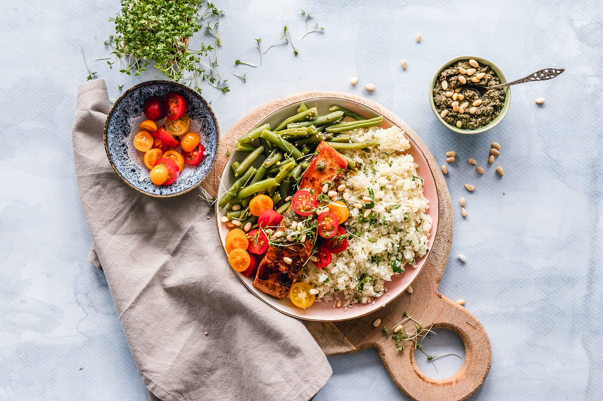

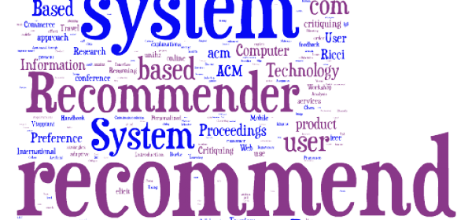
Final Deliverable
Final Deliverable
GPU usage monitor
Meal queue, seat detector
Meal recommendation

Slide 42
Thanks!
Any Questions?

